Slide 1
NEW BANQUET REGISTRATION SYSTEM
REGPACKS - https://www.regpacks.com/reg/templates/build/?g_id=100781164
You will need to create an account before registering.
Use your personal email account when registering
Indicate your home of record as an address, not your USMA address
Your credit card statement charge will read: Cadet Programs
Do not consider this a fraudulent charge!

Slide 2

Ring Banquet
Class of 2019
Ring Banquet
25 August 2018

Slide 3
Ring Banquet
Ring Banquet
25 August 2018
Reception: 1700 hrs.- Eisenhower Hall
  Legacy Photo available starting at 1600 hrs.
Dinner - 1900 hrs.-Cadet Mess
Hop – 2045 hrs. – Eisenhower Hall
    Legacy Photo available at the hop
    Bars open
    Music by Benny Haven’s Band
Banquet sign-up dates
  9-18 August (online only)
Table seat assignments
  22-25 August
Banquet set-up (Class of 2020)
  25 August 1500 hrs.

Slide 4
Ring Banquet
Terminology
  Order sheet – Results of online sign-up.
  Mandatory deduction – A fixed amount of $30 deducted from everyone in the class to cover general class weekend expenses.
    EX: Wine, wine glasses, programs, decorations, transportation, reception, VIP meals, etc.
    No exemption from mandatory deduction
  Individual deduction
    Up to $80 to be deducted for the cost of memento orders. There is no individual deduction for Ring Banquet expenses. Seats and drinks paid for when ordered.

Slide 5
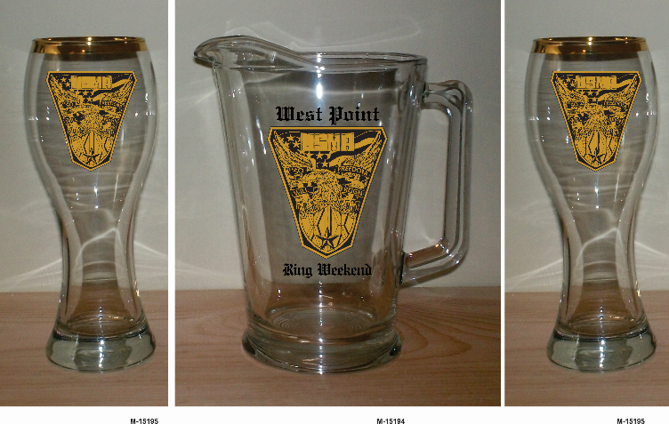
Individual Expenses
Ring Banquet
Pitcher Pilsner Set
  Pitcher and 2 glasses: $18
  Glass only: $6
  No more orders accepted
Meal for guest - $41.00
Alcoholic drinks tickets (reception)
  $3.50 each(beer or wine)
Cadet from another class
  $5 reception charge
★ MENU 
Filet Mignon
Wild Grain Rice
Mixed Vegetable Medley
Tossed Salad
Key Lime Pie
Red Wine

Slide 6
Ring Banquet
Memento
Delivery of pitcher/pilsner sets will be in Central Area on 17 August.
Company Reps will sign for the orders and distribute to those who ordered in their company. Order roster will be provided.
  Distribution:
    17 August 1000-1530 hrs.
    North Area (MAC Long)
    Bring a cart and a helper

Slide 7
Ring Banquet
Banquet and Reception sign-up
All cadets from the class must order seats online.
Only cadets may place orders. NO PARENTS!
No limit on number of guest seats.
Payment will be made when ordering.
Cadets can indicate if they are not attending.
Cadet will order and pay for reception drink tickets in advance.
  All cadets and guests must have a ticket for drinks
  Beer or wine - $3.50 ea
  Tickets will be accepted at the hop.
  No refunds!

Slide 8
Ring Banquet
Banquet and Reception sign-up
Ordering timeline: 9-18 August only!
  You will need to create an account on Regpacks. The link will also be on sharepoint
    Use your personal email account when registering.
    Indicate your home of record as an address, not your USMA address.
    Regpacks registration: https://www.regpacks.com/reg/templates/build/?g_id=100781164
    Contact Jori Reed, Cadet Programs Manager with any registration questions.

Slide 9
Late seat requests
Ring Banquet
If cadets do not order seats online by 18 August, the request will have to be sent to DCA.
Provide name of company, cadet, number of guest seats (non-cadet or cadet from another class)
Include any requests for drink tickets
Late requests will incur a $5 surcharge per seat.
Seats must be paid for before they are allocated.
Late requests may have to sit out-of-company.
Other late requests to sit in another company (after 19 August) will not be honored.

Slide 10
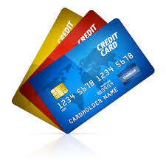
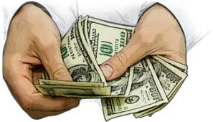
Payment for late requests
Ring Banquet
Payable by cash or credit at Cadet Programs in DCA
  Ike Hall-3rd floor
  0830-1600 hrs.
Extra seats will be withdrawn if payment is not received.
Late requests may not sit in company if space is not available.

Slide 11
Ring Banquet
Flower/Corsage orders
Pedals and Blooms: At the PX – (845)446-3848
Lily’s of the Valley: In Highland Falls – (845)446-4446
Turn in corsage and flower orders directly with the business
DCA does not handle flower orders
The vendors will deliver company orders to CGR. Most require orders be turned in by approximately Tuesday of the week of the event.

